Slide 1

Relation

Slide 2
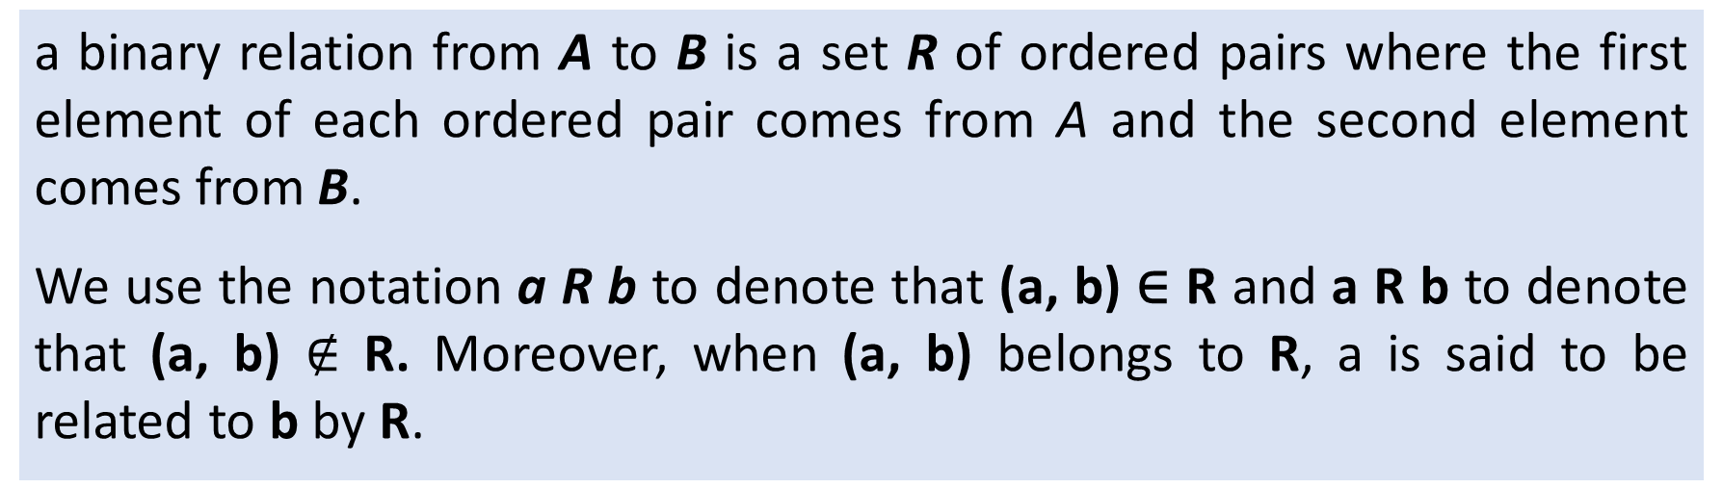
Relation
Definition
a binary relation from A to B is a set R of ordered pairs where the first element of each ordered pair comes from A and the second element comes from B.
We use the notation a R b to denote that (a, b) ∈ R and a R b to denote that (a, b) $∉$R. Moreover, when (a, b)belongs to R, a is said to be related to b by R.
Let A and B be sets. A binary relation from A to B is a subset of A×B.
Application : Relational database model is based on the concept of relation.

Slide 3
Relation : Example
Let A be the students in the Dept. of CSE
A = {Ruhul, Shanta, Sarfar, Dipti}
Let B be the courses the department offers
B = {CSE 201, CSE 202, CSE 203}
We specify relation R ⊂ A × B as the set that lists all students a ∈ A enrolled in class b ∈ B
R = {(Ruhul, CSE 201), (Shanta, CSE 202), (Shanta, CSE 203), (Sarfar, CSE 202), (Dipti, CSE 203)}

Slide 4
More relation examples
Relation : More Example
Another relation example:
Let A be the Districts in the Bangladesh
Let B be the Division in the Bangladesh
We define R to mean a is a district in division b
Thus, the following are in our relation:
(Nator, Rahjshahi)
(Jayputhat, Rajshahi)
(Tongi, Dhaka)
(Bagerhat, Khulna)
etc…
Most relations we will see deal with ordered pairs of integers

Slide 5
Representing relations
We can represent relations graphically
We can represent relations in a table
Nadira
Sojib
Sakira
Asma
 | CSE 201 | CSE 202 | CSE 203
Nadira | 1 | 0 | 0
Sojib | 0 | 1 | 1
Sakira | 0 | 0 | 0
Asma | 0 | 1 | 1
CSE 201
CSE 202
CSE 203
Not valid functions!

Slide 6
Relations vs. functions
If R ⊂ X × Y is a relation, then is R a function?
If f: X → Y is a function, then is f a relation?

Slide 7
Inverse Relation
Definition
Let R be any relation from a set A to a set B. The inverse of R, denoted by R⁻¹, is the relation from B to A, which consists of those ordered pairs which, when reversed, belong to R; that is,
R⁻¹ = {(b, a)|(a, b)∈R}
For example, let A={1,2,3} and B={x, y, z}. Then the inverse of R={(1, y), (1, z), (3,y)}
Then the inverse relation is R⁻¹ = {(y,1), (z,1), (y,3)}
Inverse or Inverse is ?

Slide 8
Relations on a set
Definition
A relation on the set A is a relation from A to A
In other words, the domain and co-domain are the same set
We will generally be studying relations of this type

Slide 9
Relations on a Set : Example
Let A be the set { 1, 2, 3, 4 }
Which ordered pairs are in the relation
R = { (a,b) | a divides b }
R = {(1,1), (1,2), (1,3), (1,4), (2,2), (2,4), (3,3), (4,4)}
1
2
3
4
1
2
3
4
R | 1 | 2 | 3 | 4
1 | X | X | X | X
2 |  | X |  | X
3 |  |  | X
4 |  |  |  | X

Slide 10
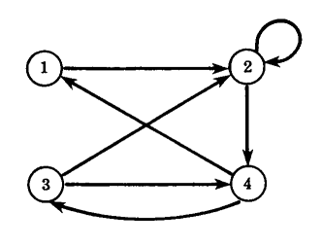
Directed Graphs of Relations on Sets
Consider the relation R on the set A={1,2,3,4} :
There is an important way of picturing a relation R on a finite set.
First we write down the elements of the set
Draw an arrow from each element x to each element y when ever x is related to y.
This diagram is called the directed graph of the relation.
R={(1,2), (2,2), (2,4), (3,2), (3,4), (4,1), (4,3)}

Slide 11
More examples
Relations on a Set : Example
Consider some relations on the set Z
Are the following ordered pairs in the relation?
(1,1) (1,2) (2,1) (1,-1) (2,2)
R₁ = { (a,b) | a≤b }
R₂ = { (a,b) | a>b }
R₃ = { (a,b) | a=|b| }
R₄ = { (a,b) | a=b }
R₅ = { (a,b) | a=b+1 }
R₆ = { (a,b) | a+b≤3 }
X
X
X
X
X
X
X
X
X
X
X
X
X
X
X

Slide 12
Relation properties
Properties of Relations
Properties of relations we will study:
Reflexive
Symmetric
Antisymmetric
Transitive

Slide 13
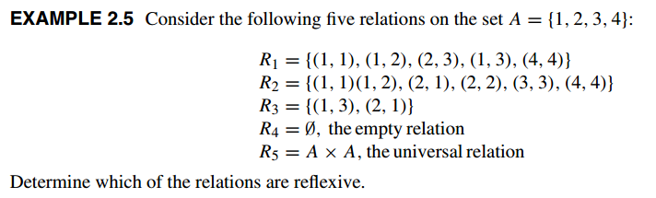

Reflexivity
Reflexivity
Definition: A relation is reflexive if
(a, a) ∈ R for all a ∈ A

Slide 14
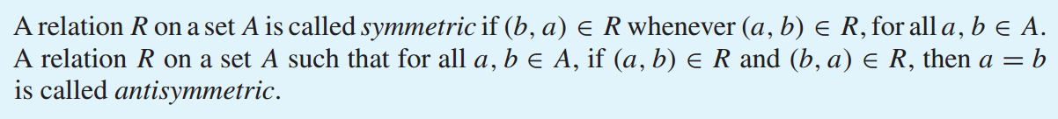
Symmetric and Antisymmetric Relations
Definition

Slide 15

Symmetric and Antisymmetric Relations
A relation is symmetric if
for all a, b ∈ A, (a,b) ∈ R⇒ (b,a) ∈ R
A relation is antisymmetric if
for all a, b ∈ A, (a,b) ∈ R ⇒ (b,a) ∉ R

Slide 16
Transitivity
Definition

Slide 17
Transitivity
Transitivity
A relation is transitive if
for all a, b, c ∈ A, ((a,b)∈R ∧ (b,c)∈R) ⇒ (a,c)∈R
If a < b and b < c, then a < c
Thus, < is transitive
If a = b and b = c, then a = c
Thus, = is transitive

Slide 18
Summary of properties of relations
reflexive | ∀a (a, a) ∈ R
irreflexive | ∀a (a, a) ∉ R
symmetric | ∀ a, b ∈ A, (a,b) ∈ R ⇒ (b,a) ∈ R
asymmetric | ∀ a, b ∈ A, (a,b) ∈ R ⇒ (b,a) ∉ R
antisymmetric | ∀ a, b ∈ A, ((a,b) ∈ R ∧ (b,a) ∈ R) ⇒ a=b ^{(*)}for all a, b ∈ A, ((a,b) ∈ R ∧ a ≠ b) ⇒ (b,a) ∉ R)
transitive | ∀ a, b, c ∈ A, ((a,b) ∈ R ∧ (b,c) ∈ R) ⇒ (a,c) ∈ R
^{(*)} Alternative definition…

